Slide 1
DIABETES PREDICTION
G.Pullaiah College of Engineering & Technology
Computer Science and Engineering
PROJECT BY:
S.K.JAHNAVI
20at1a0555

Slide 2
OVER VIEW:
Pain point:
As there is an increase level and decrease level in the population of diabetes and also some of them are leading to the deaths.The prevalenvce of diabetes in india has rised from 7.1% in 2009 to 8.9% in 2019 and the estimated no.Of diabetes patients in 20-79 age group is 74.2 millions in 2021.
Existing system:
The A1C test is also the primary test used for diabetes management. An A1C test is a blood test that reflects your average blood glucose levels over the past 3 months. The A1C test is sometimes called the hemoglobin A1C, hba1c, glycated hemoglobin, or glycohemoglobin test.
Proposing system:
This proposing system can predict whether a person is having diabetes or not based on his health condition.

Slide 3
DATA SET:
Business Usecase: One should be in a position to be well aware of his health condition.
Features: Some Of The Features Are-
• Glucose
• Pregnancies
• Blood Pressure
• Skin Thickness
• Insulin
• BMI
• Diabetespedigreefunction
• Age
Target Variable:
Target variable represents the diabetespedigreefunction.
Categorical Variable:
Categorical variable represents that whether a person is diabetic or not.

Slide 4
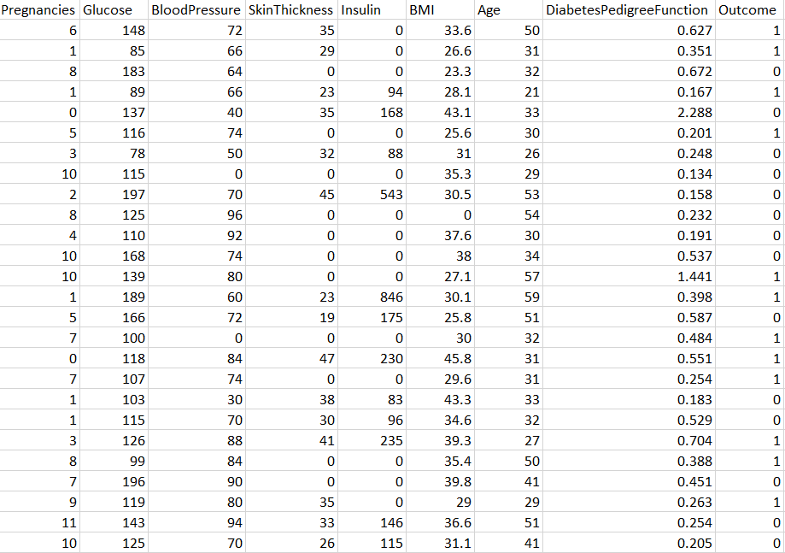
DATA SET:

Slide 5
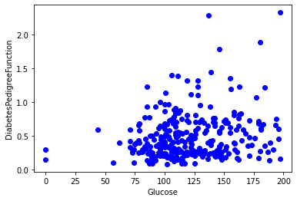
OBSERVATIONS:

Slide 6
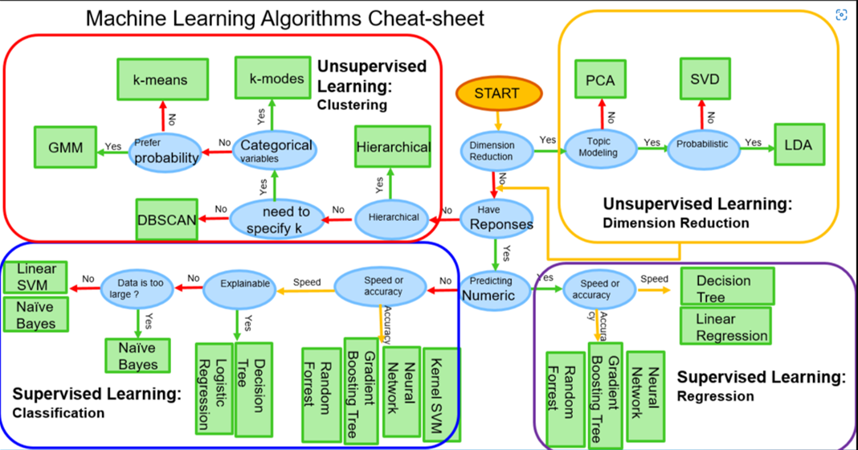
MODEL SELECTION:

Slide 7
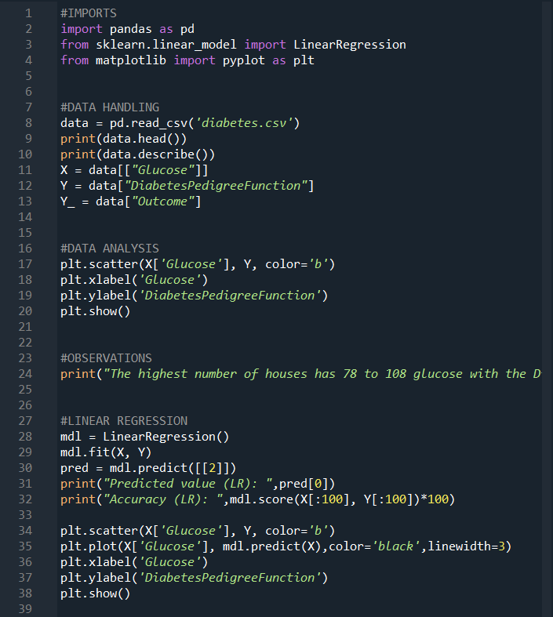
CODE:

Slide 8
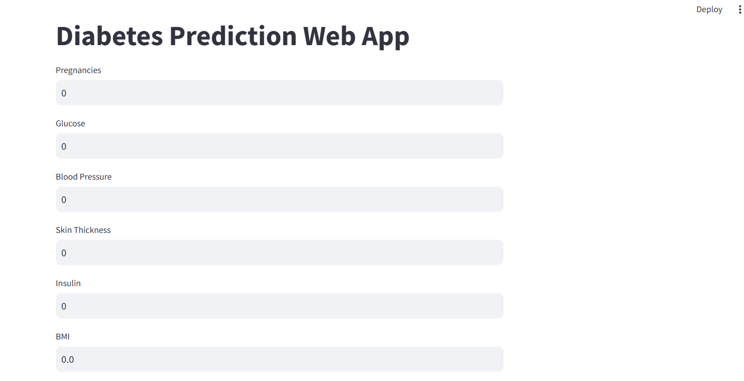
WEB APP

Slide 9
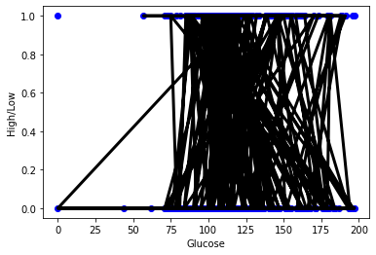
RESULT:

Slide 10
THANK YOU

